Slide 1





Topic -
Bachelor of Technology
in
Computer Science
&
Information Technology
E-commerce Store Build an online store for selling products like clothes, electronics, or handmade crafts. Include product pages, a shopping cart, and a checkout process.
E-commerce Store: Build an Online Sales Platform
Members - 1. Mayank Soam(2428CSIT1335)
2. Prateek Singh(2428CSIT1765)
S.NO. Library Id Name Uviversity Id
1. 2428CSIT1765 Prateek Singh 202401100500132
2. 2428CSIT1335 Mayank 202401100500102
In today's digital age, having an online store is crucial for any business. It allows you to reach a wider audience, expand your reach beyond geographical limitations, and increase your revenue potential.
1st Year 1st Semester 2024-25 Batch
Topic - E-commerce Store Build an online store for selling products like clothes, electronics, or handmade crafts. Include product pages, a shopping cart, and a checkout process.
by Prateek Singh (2428CSIT1765)
And Mayank (2428CSIT1335)
Notes:
1

Slide 2
Introduction: Why Sell Online?
Expanded Reach
Increased Revenue
Data-Driven Insights
Reach customers globally, breaking down geographic barriers.
24/7 accessibility boosts sales and opens new revenue streams.
Analyze customer behavior and tailor your offerings.
Notes:
2

Slide 3
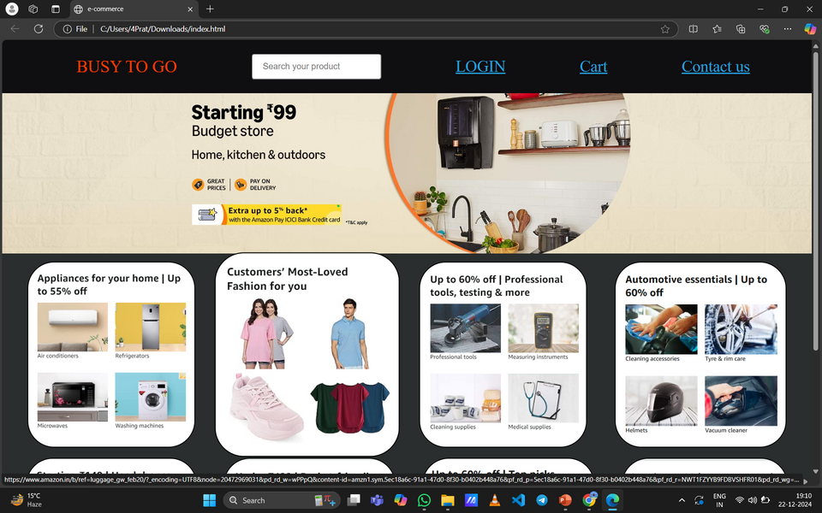
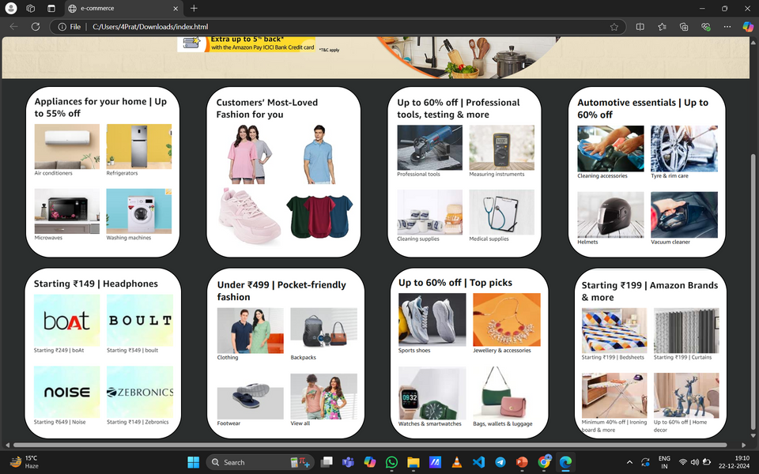
Key Features of an E-commerce Website
1
Product Catalog
2
Shopping Cart
Showcase your inventory with clear product descriptions, high-quality images, and pricing.
Allow users to add products and manage their orders with ease.
3
Secure Checkout
4
Customer Account
Provide a secure and reliable checkout process with multiple payment options.
Enable account creation for personalized experiences and order tracking.
Notes:
3

Slide 4
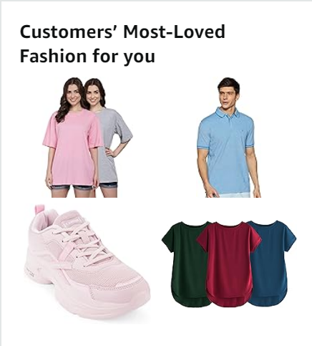


Website Photos
Professional Photography
Invest in professional product photography that showcases your products in their best light.
High Resolution
Use high-resolution images that are clear and detailed, allowing customers to see every aspect of the product.
Notes:
5

Slide 5
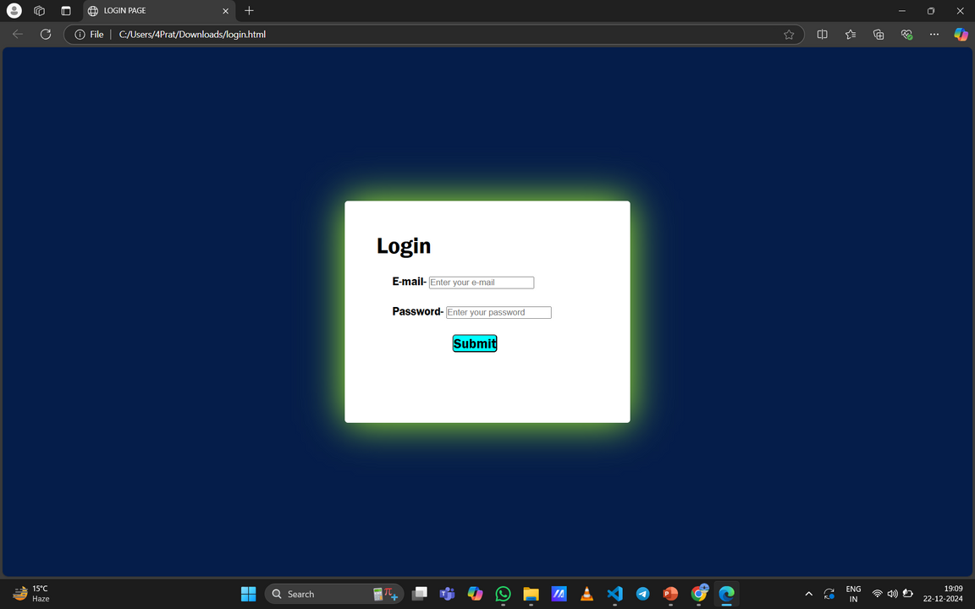
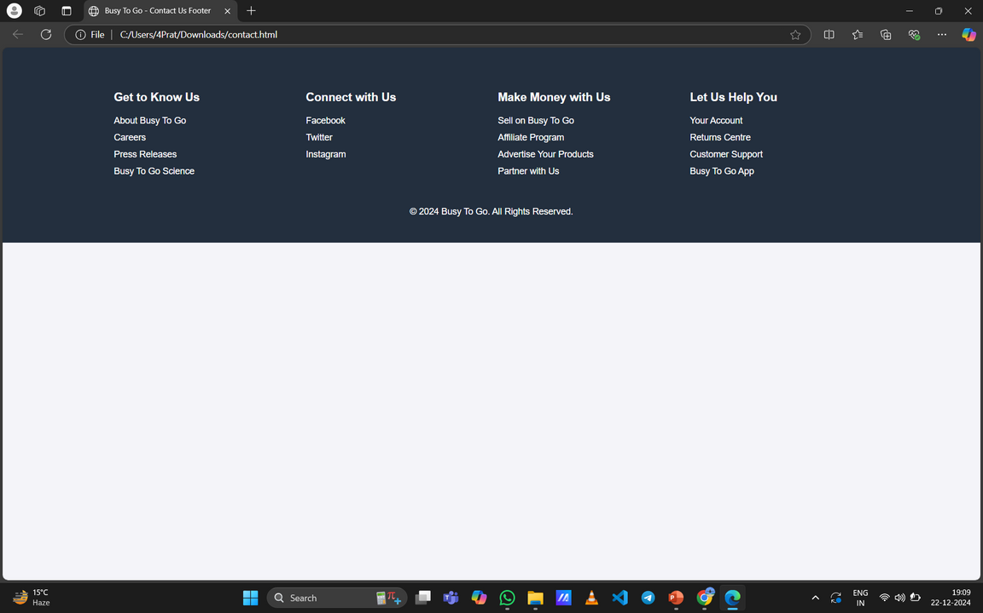
Pages in website -
Login page - Contact page -

Slide 6
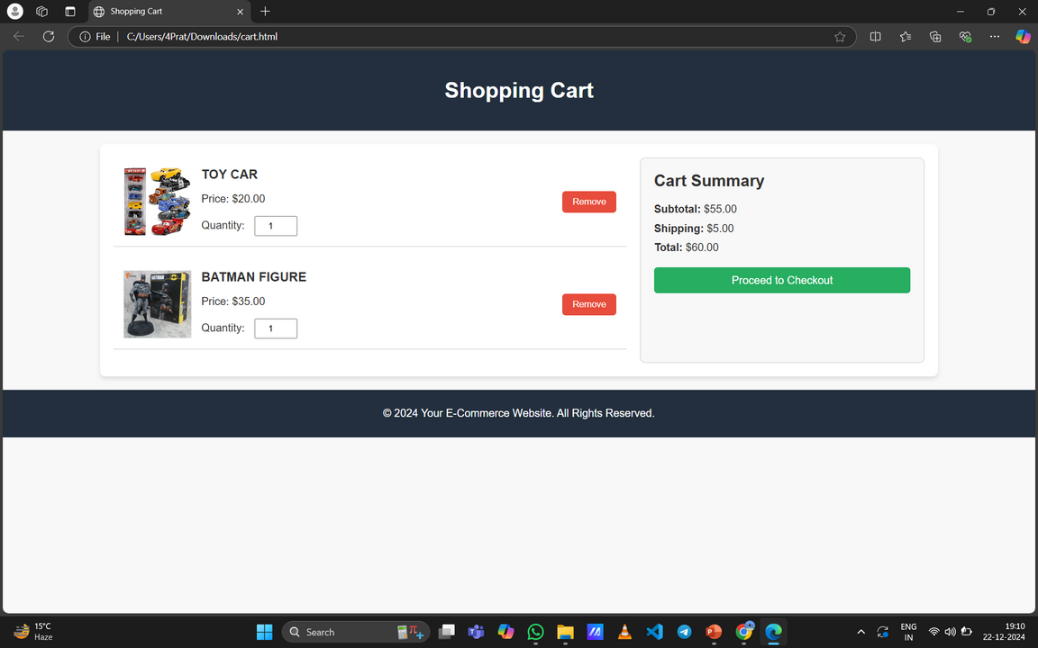
Shopping Cart and Checkout Process
1
Add to Cart
Make it easy for customers to add items to their cart with a simple button or click.
2
View Cart
Allow customers to review their cart and update quantities or remove items.
3
Checkout
Offer a secure and streamlined checkout process with clear instructions.
4
Order Confirmation
Send an email confirmation with order details and tracking information.
Notes:
7

Slide 7
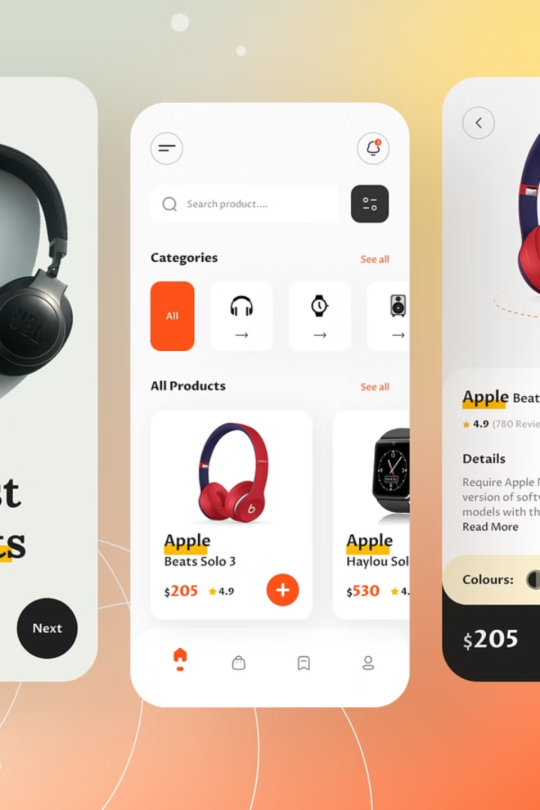



Optimizing for Mobile Devices
Responsive Design
Ensure your website adapts to different screen sizes and devices for a seamless user experience.
Fast Loading Speeds
Optimize images and code to ensure fast loading times on mobile devices.
Easy Navigation
Design a simple and intuitive navigation menu that is easy to use on touchscreens.
Notes:
8

Slide 8




Conclusion: Keys to E-commerce Success
Customer Focus
1
Prioritize customer needs and provide a seamless shopping experience.
2
Quality Products
Offer high-quality products that meet customer expectations.
Strong Branding
3
Develop a consistent brand identity and messaging that resonates with your target audience.
Marketing and Promotion
4
Utilize various marketing channels to reach your target audience and drive traffic to your store.
Notes:
9

Slide 9
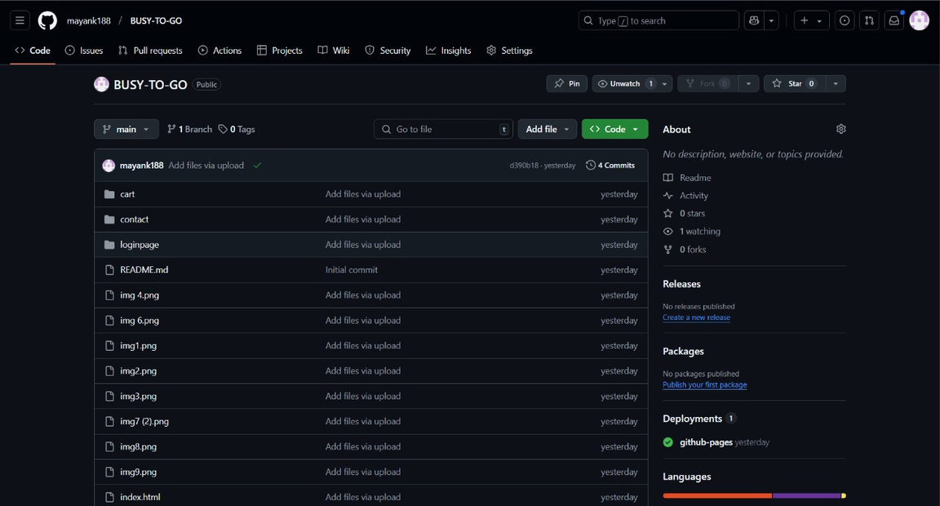
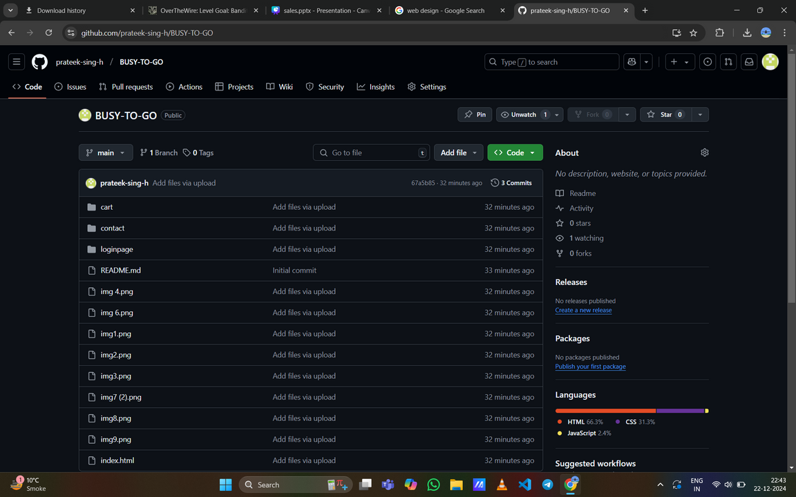
Github project upload -
1- https://mayank188.github.io/BUSY-TO-GO/
2- https://github.com/prateek-sing-h/BUSY-TO-GO

Slide 10
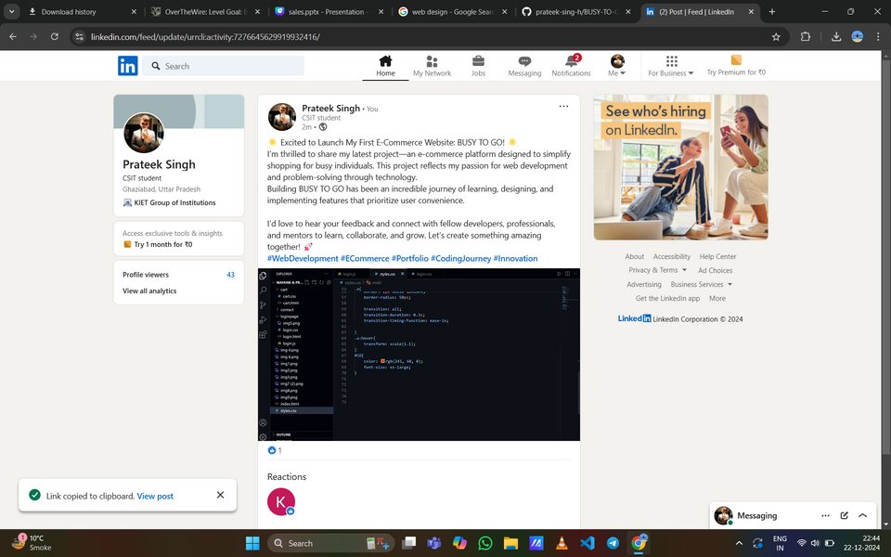
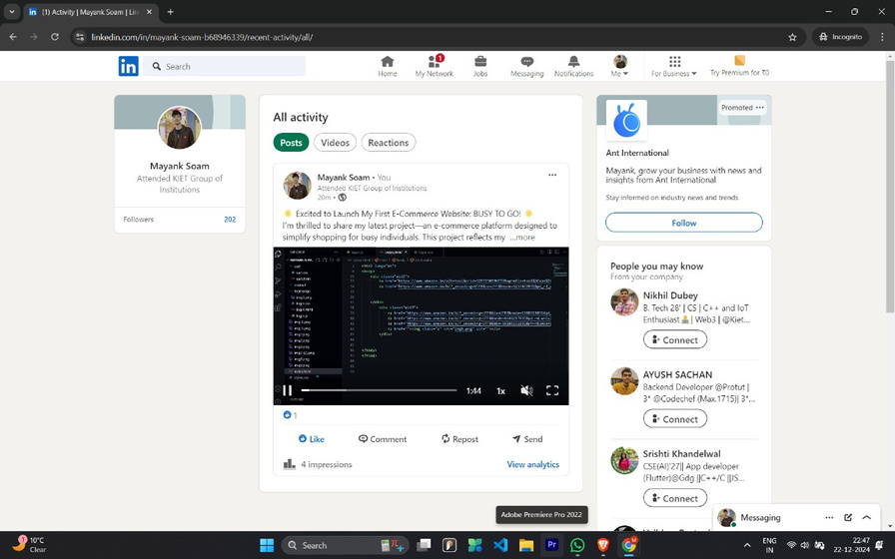
LinkedIn-
1- https://www.linkedin.com/posts/prateek-singh-a69920320_webdevelopment-ecommerce-portfolio-activity-7276645629919932416-ak1u?utm_source=share&utm_medium=member_desktop
2- https://www.linkedin.com/posts/mayank-soam-b68946339_webdevelopment-ecommerce-portfolio-activity-7276641757822382080-lpxa?utm_source=share&utm_medium=member_desktop

Slide 11
THANK YOU
for your attention

